Slide 1

Business Intelligent
PRESENT BY: SHALOMSHAN
BATCH: CSD
08

Slide 2


Agenda
What is the Business Intelligence (BI) tools?
List of BI Tools
Tableau
Qlik
Microsoft Power BI
Dandus BI
Sisense
Conclusion

Slide 3

What is the business intelligence (BI) tools?
Business inteligence (BI) tools are types of application software collect and process large amounts of unstructured data from internal and external systems, including books, journals, documents, helth records, images, files, email, video and other business sources.

Slide 4
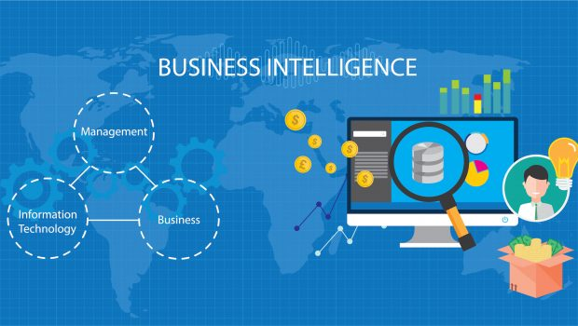
List of BI Tools
Tableau
Qlik
Microsoft Power BI
Dandus BI
Sisense

Slide 5

Tableau
Tableau Develop Organization: Data Visualization Company
Features of Tableau:
Tableau Dashboard
Collabrading & Sharing
Live & In memory Data
Data sources in Tableau
Advanced visualizations
Maps
Robust Security
Mobile view
Ask data
Trent data & Predicitive analysis

Slide 6
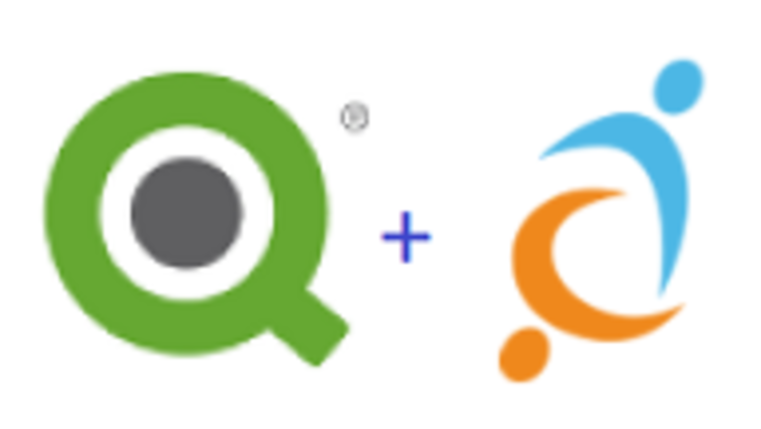
Qlik
Qlik Develop Organization: Qlik
Features of Qlik:
Natural analytics and data discovery
Data collaboration and connectivity
Mobility and scalability
Social data discovery
Enterprise platform capabilities
Interactive guided analytics
In-memory storage technology
Agile application development
Associative model
Comparative analysis

Slide 7


Microsoft Power BI
Microsoft Power BI Develop Organization: Microsoft
Features of Microsoft Power BI:
Range of Attractive Visualizations
Get Data (Data Source)
Datasets Filtration
Customizable Dashboards
Flexible Tiles
Navigation Pane
Informative Reports
Natural Language Q & A Question Box
DAX Data Analysis Function
Help & Feedback Buttons

Slide 8

Dandu's BI
Dandus BI Develop Organization: Qlik
Features of Qlik:
Dashboards
Communication and Collaboration Tools
Slideshows
Data Visualizations
Superb Interactivity
Rich, Interactive Scorecards
Tables
Charts
Gauges
Maps

Slide 9
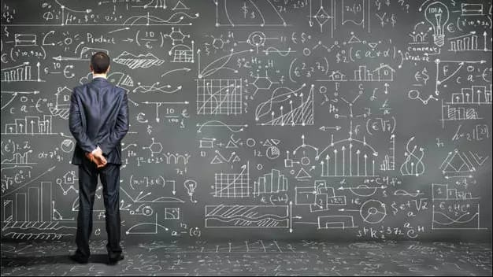
Sisense
Sisense Develop Organization: Sisense
Features of Qlik:
Integrates with web portals
Use Single-Sign-On to keep a single authentication mechanism
Exports data to CSV, PDF, Excel, Images and other formats
Interactive browser-based dashboards
Eye-grabbing visualization
Removes limitations to data size
Filters data by dropping fields on the canvas
Wide range of widgets such as gauges, charts, and graphs
Embed entire dashboards or individual widgets
Data unification

Slide 10
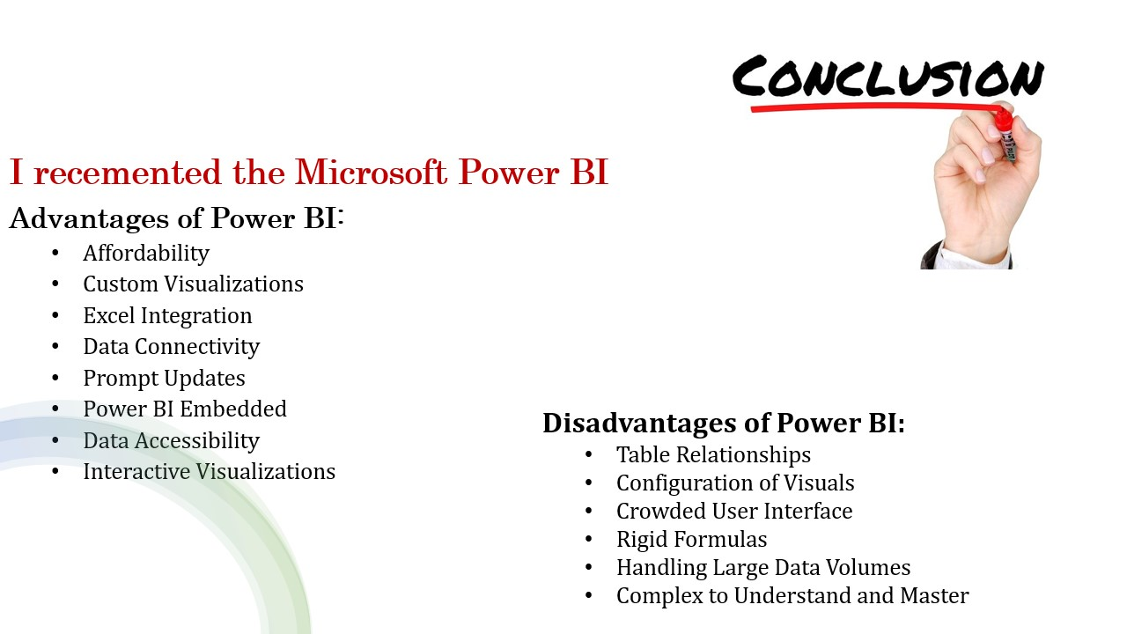


Slide 11


